Slide 1


Stephanie Goodman
June 2024

Slide 2

Outline
Executive Summary
Introduction
Methodology
Results
Conclusion
Appendix

Slide 3
Executive Summary
Summary of methodologies
Data Collection using API
Data Collection using Web Scraping
Data Wrangling
Exploratory Data Analysis with SQL
Exploratory Data Analysis with Visualization
Interactive Visual Analytics using Folium
Machine Learning Prediction
Summary of all results
Results of Exploratory Data Analysis
Demonstration of Analysis Through Visualization
Results of Predictive Analysis

Slide 4
Introduction
Space X: Cost Effective Solutions
According to official SpaceX marketing, the Falcon 9 rocket costs approximately $62 million per launch.
Compared to other providers Falcon 9 launches are over 90% cheaper than competitors, who average $165 million + per launch.
To decrease costs, SpaceX plans to reuse the first stage.
Our goal is to determine the cost of a launch by using data science methods to determine whether the first stage of a launch will be a success. A launch is considered successful if the rocket lands in the expected location with no damage.
Issues to be Addressed:
What factors impact whether a launch will be successful?
What variables impact the success rate of launches? Which variables affect launches most?
What are the ideal conditions for a SpaceX rocket to have the highest probability of success?

Slide 5

Section 1

Slide 6
Methodology
Executive Summary
Data collection methodology:
Data was collected from the SpaceX Wikipedia page.
Data was collected via HTML web scraping through the SpaceX Rest API.
Perform data wrangling
One-hot encoding was applied to categorical features to clean the dataset.
Perform exploratory data analysis (EDA) using visualization and SQL
Perform interactive visual analytics using Folium and Plotly Dash
Perform predictive analysis using classification models
How to build, tune, evaluate classification models

Slide 7
Data Collection
Publicly available SpaceX launch data was gathered from the SpaceX REST API
The REST API provided launch data that included variables like payload delivered, launch specifications, and outcomes
Data was obtained from the API using a .get() request.
The response was decoded as a .json() object, and was transformed to a pandas dataframe using the .json_normalize() method
Additional data was collected using web scraping methods on the SpaxeX Wikipedia page using the BeautifulSoup Python library.

Slide 8

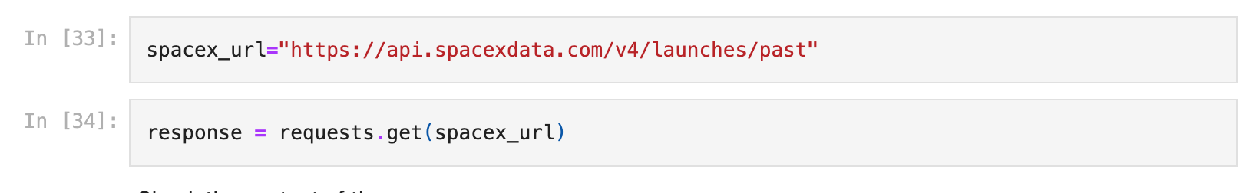
Data Collection – SpaceX API
Using a get request, we were able to use the SpaceX API to collect data and complete some basic data cleaning and formatting.
Link to the GitHub notebook further detailing this process: https://github.com/stephaniegoodman/spacex_flightanalysis/blob/e80658124600ae5d3bc37c6c6e45107e9f5044ba/Data_Collection_API.ipynb
SpaceX
REST API
Filtering
(falcon 9, clean data)
API returns data in .JSON
Data that has been normalized and stored in a flat .csv file

Slide 9
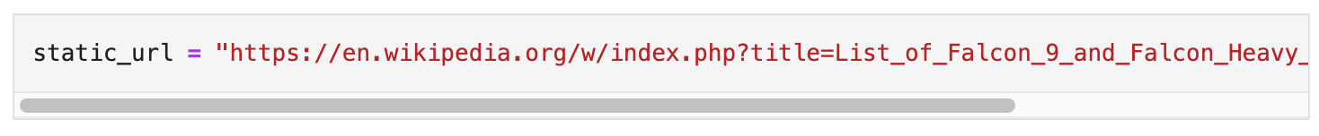
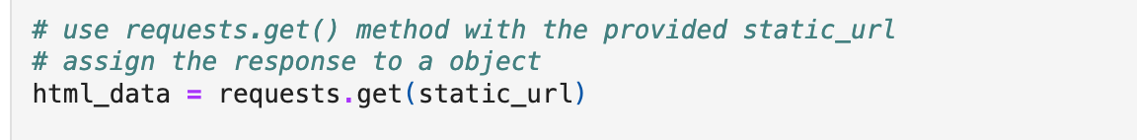
Data Collection - Scraping
Using BeautifulSoup, we applied web scraping to the Falcon 9 Launches page on Wikipedia to obtain launch records
Link to the GitHub notebook further detailing this process: https://github.com/stephaniegoodman/spacex_flightanalysis/blob/e80658124600ae5d3bc37c6c6e45107e9f5044ba/Data_Collection_WebScraping.ipynb
HTML
response
BeautifulSoup to extract data
Parse HTML table → dictionary
Data that has been normalized and stored in a flat .csv file

Slide 10

Data Wrangling
Launch outcomes varied based on landing location and overall success. To decrease confusion, outcomes were converted to 0 for failure, and 1 for success.
Calculations were performed to determine number of launches per site, number and occurrence of each orbits. A diagram detailing common orbit types used at SpaceX is included on this slide.
Results were exported to a .csv file.
Link to the GitHub notebook further detailing this process: https://github.com/stephaniegoodman/spacex_flightanalysis/blob/e80658124600ae5d3bc37c6c6e45107e9f5044ba/Data_Wrangling.ipynb

Slide 11
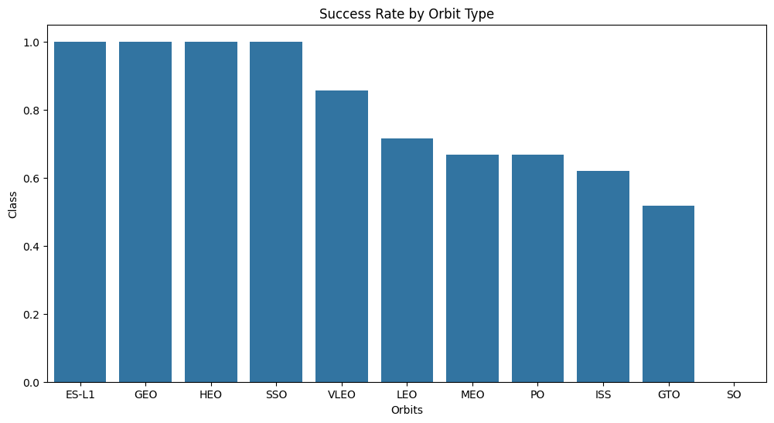
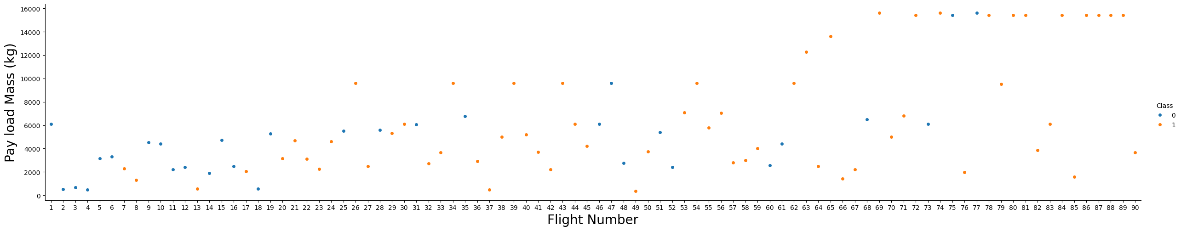
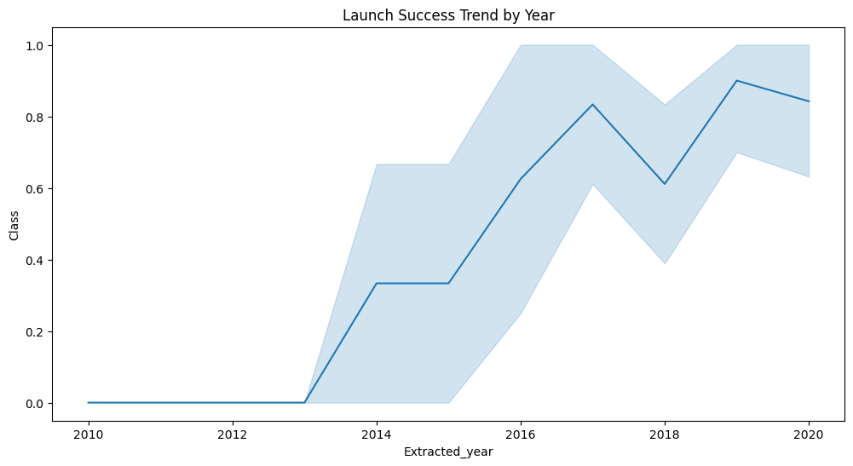
EDA with Data Visualization
Scatter plots were used to compare different quantitative variables, including
Flight Number vs Payload Mass:
Bar graphs were used to compare categories and discrete values, such as:
The relationship between Success Rate and Orbit Type
Line Graphs were used to display variables and trends over time:
Success Rate by Year
Link to the GitHub notebook further detailing this process:
https://github.com/stephaniegoodman/spacex_flightanalysis/blob/e80658124600ae5d3bc37c6c6e45107e9f5044ba/EDA_with_Visualization.ipynb

Slide 12
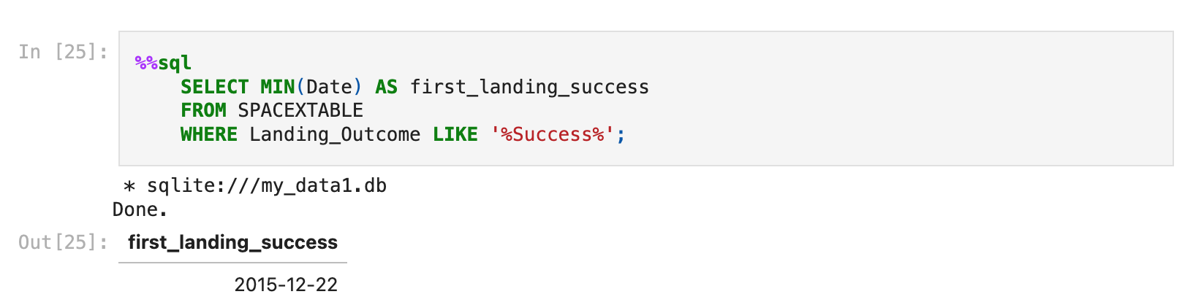
EDA with SQL
Using SQLAlchemy, queries were performed on the dataset to create tables that provide further context for launch sites, site outcomes, and larger generalizations.
Link to the notebook on GitHub further detailing this process: https://github.com/stephaniegoodman/spacex_flightanalysis/blob/e80658124600ae5d3bc37c6c6e45107e9f5044ba/EDA_With_SQL.ipynb

Slide 13
Build an Interactive Map with Folium
Launch data was incorporated into an interactive map with Folium through this process:
Latitude and Longitude coordinates were taken at each launch site
A circle marker was added around each launch site with a label for each launch site name.
Using Green and Red markers, launch outcomeswere color coordinated (0 = Red, unsuccessful, 1 = Green, successful).
The distance between a launch site and other varied landmarks was calculated using Haversine’s Formula. This was done so to determine various trends regarding launch site location.
Lines were drawn on the map to measure distance from landmarks
Link to the notebook on GitHub further detailing this process:
https://github.com/stephaniegoodman/spacex_flightanalysis/blob/e80658124600ae5d3bc37c6c6e45107e9f5044ba/Interactive_Visual_Analysis_with_Folium.ipynb

Slide 14
Build a Dashboard with Plotly Dash
Using Plotly Dash, an interactive dashboard was created.
This dashboard was hosted on a local URL for ease of access.
Features provided for interactivity included dropdown menus to select year or launch site.
Pie charts displayed total launches by specific sites
Scatter graphs displayed the relationship between Payload Mass (Kg) and Outcomes based on specific booster versions
Link to the notebook on GitHub further detailing this process: https://github.com/stephaniegoodman/spacex_flightanalysis/blob/e80658124600ae5d3bc37c6c6e45107e9f5044ba/Interactive_Dashboard.py

Slide 15
Predictive Analysis (Classification)
Building the Model: data was loaded, transformed, split into training and test datasets, machine learning algorithms were chosen, parameters were set, and datasets were fit into GridSearchCV objects to train the dataset.
Model Evaluation: Accuracy metrics were reviewed, best hyperparameters were determined, and a Confusion Matrix was plotted for each model
Model Improvement: The model was improved using feature engineering and algorithm tuning
The best performing classification model was defined as the model with the best accuracy score.
Link to the notebook on GitHub further detailing this process:
https://github.com/stephaniegoodman/spacex_flightanalysis/blob/e80658124600ae5d3bc37c6c6e45107e9f5044ba/Interactive_Dashboard.py

Slide 16
Results
Exploratory data analysis results
Interactive analytics demo in screenshots
Predictive analysis results

Slide 17

Section 2

Slide 18
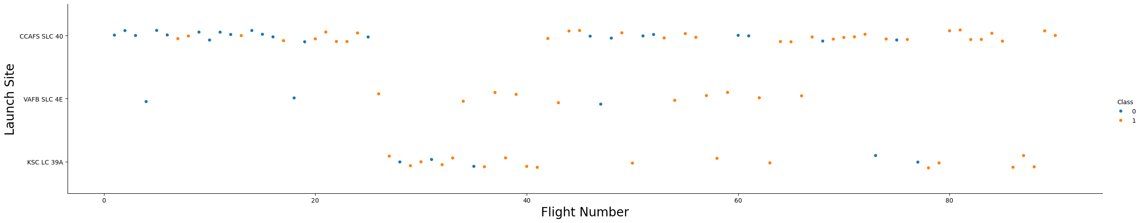
Flight Number vs. Launch Site
Higher numbers of flights are correlated with higher success rates.

Slide 19
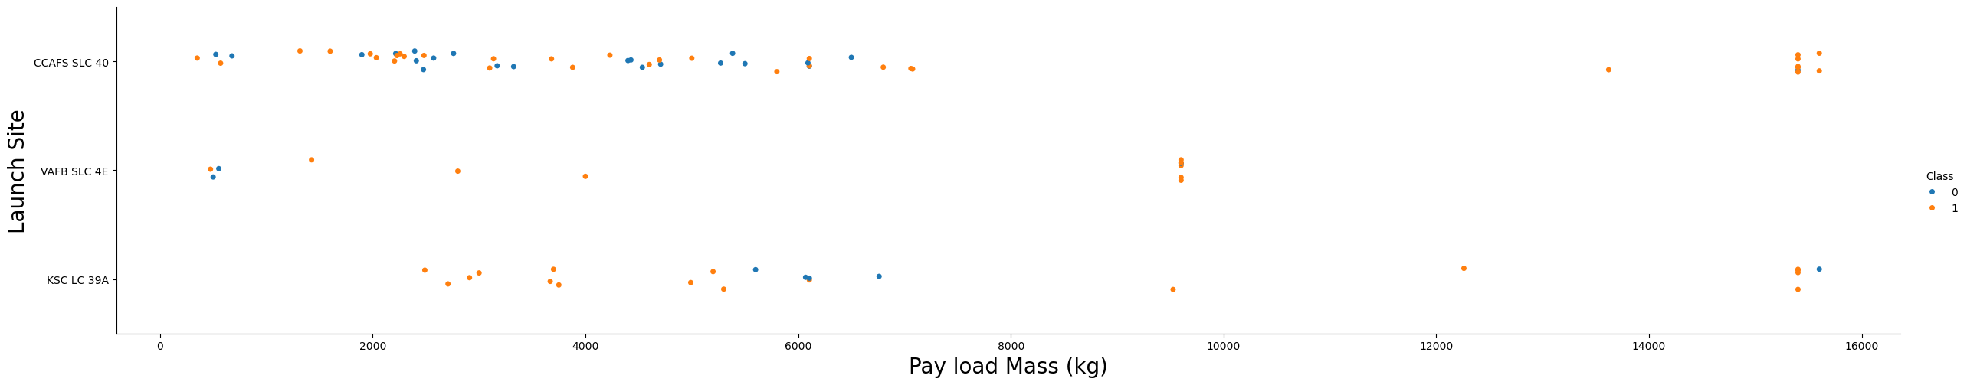
Payload vs. Launch Site
For launch site CCAFS SLC 40, higher payload mass is associated with higher rocket success rate. There are not clear enough patterns among the other two launch sites to suggest a relationship between launch site and payload mass.

Slide 20
Success Rate vs. Orbit Type
Orbit types ES-L1, GEO, HEGO, and SSO have the highest success rates of all orbit types.

Slide 21
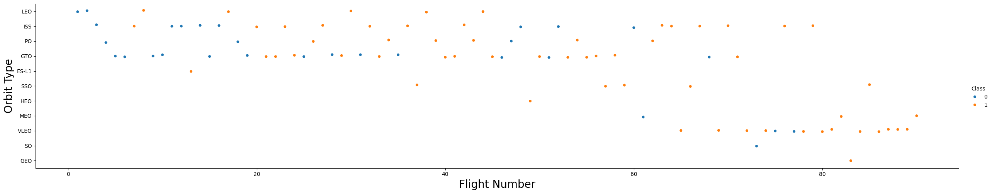
Flight Number vs. Orbit Type
In the LEO orbit, success is correlated with flight number. For other orbit types, there is no clear relationship between flight number and orbit type.

Slide 22
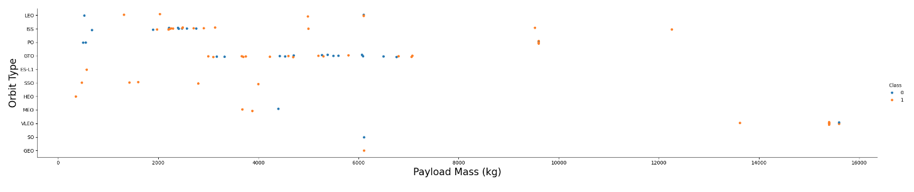
Payload vs. Orbit Type
Landings are more likely to be successful with heavy payloads for PO, LEO, and ISS orbits.

Slide 23
Launch Success Yearly Trend
Success rate increased from 2013-2020, with one notable peak in 2016.

Slide 24
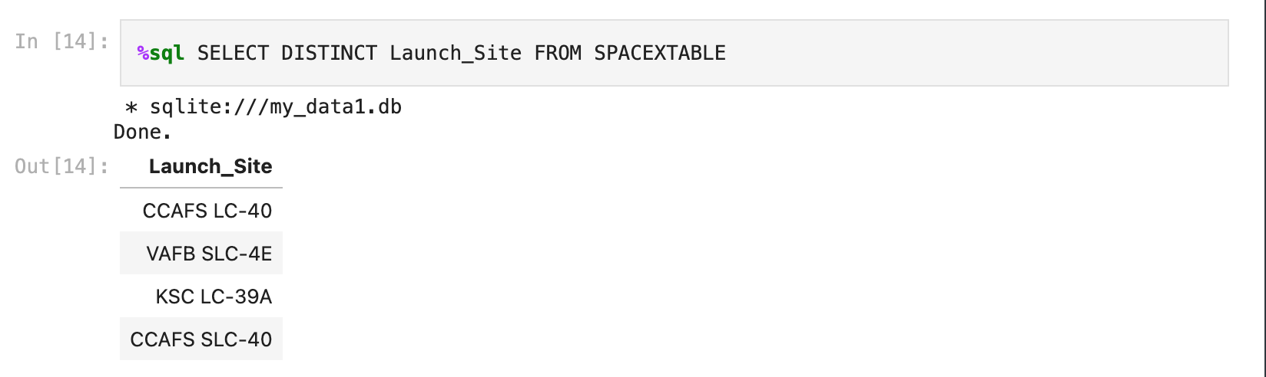
All Launch Site Names
Using a SQL query including a DISTINCT operator in the SELECT clause resulted in a list of all unique launch site names

Slide 25
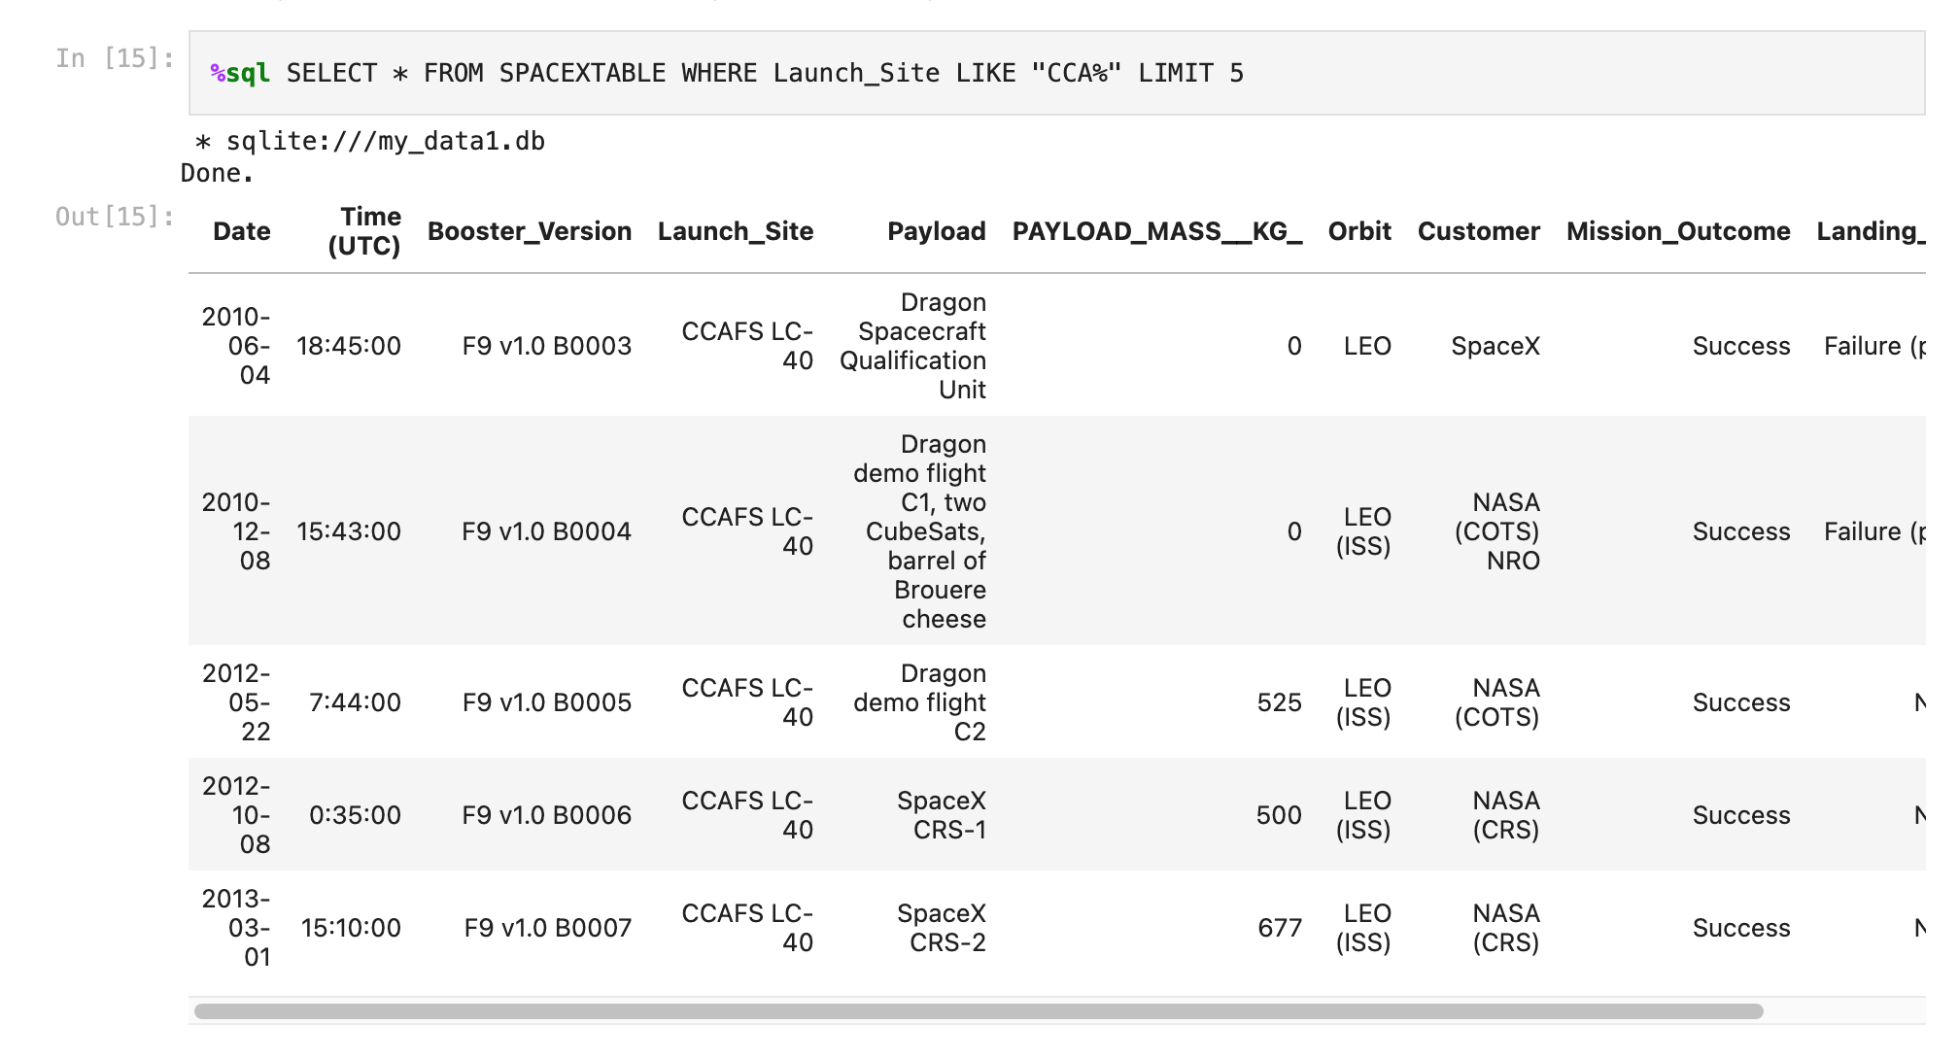
Launch Site Names Begin with 'CCA'
Using the LIKE operator in the WHERE clause, as well as a LIMIT clause in this SQL query returned 5 records where launch sites begin with ‘CCA’

Slide 26
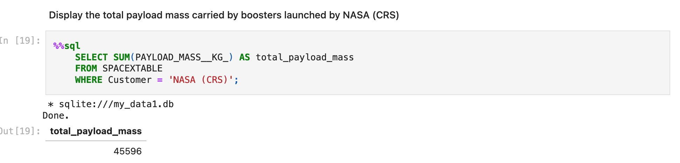
Total Payload Mass
The aggregate function SUM() combined with a WHERE clause specifying customer type as NASA returns the total payload carried by boosters from NASA

Slide 27
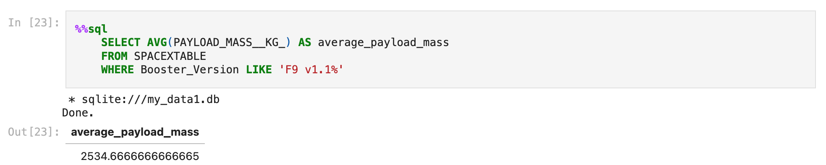
Average Payload Mass by F9 v1.1
The aggregate function AVG() combined with a WHERE clause specifying booster version returns the average payload mass carried by booster version F9 v1.1

Slide 28
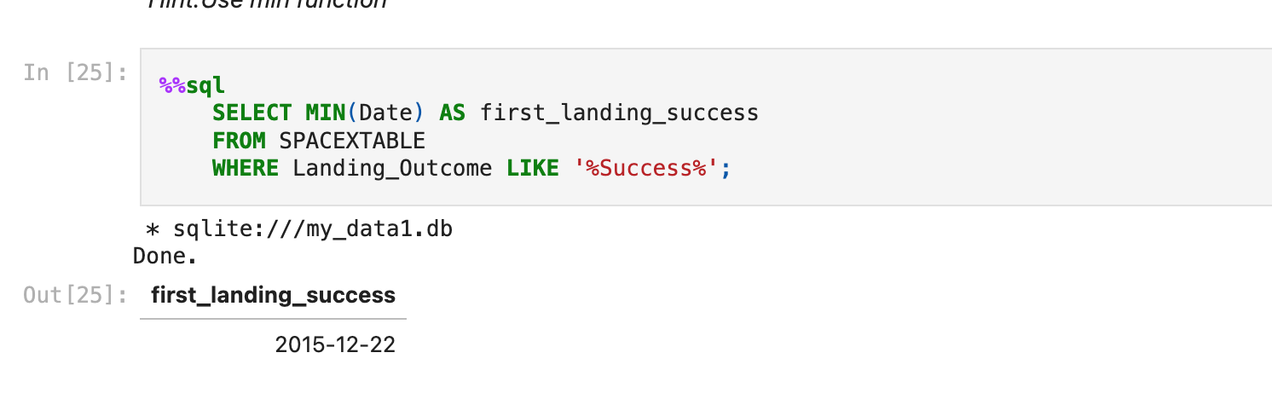
First Successful Ground Landing Date
The use of the MIN() function combined with the LIKE operator in the WHERE clause allows us to determine the date of the first successful landing

Slide 29
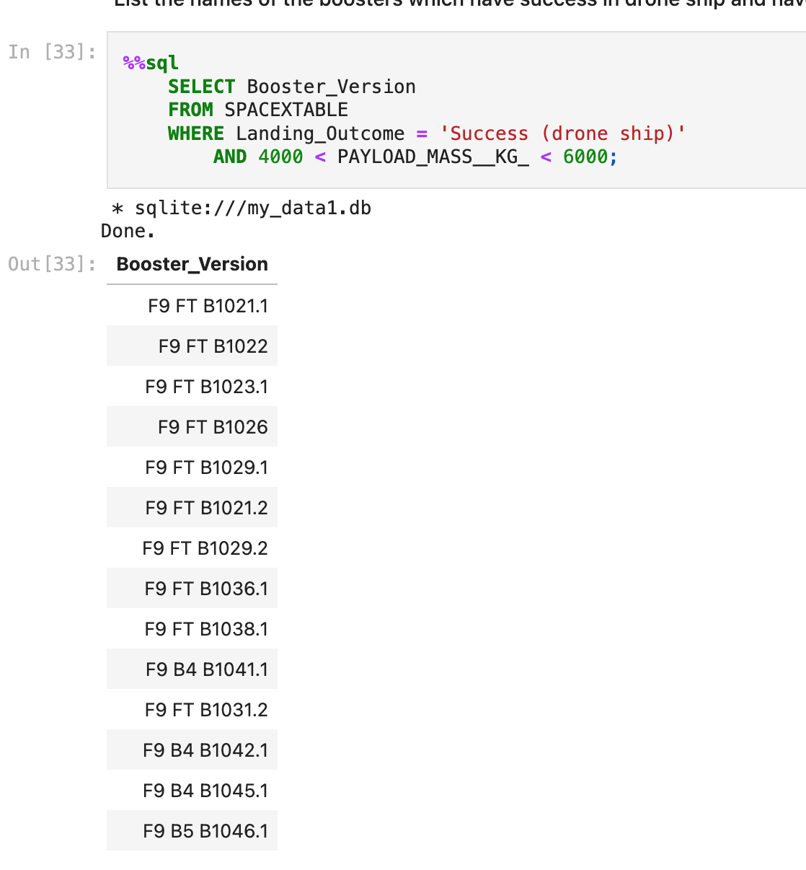
Successful Drone Ship Landing with Payload between 4000 and 6000
The use of inequality symbols < > and a specified WHERE clause returns the list of successful booster versions where the payload is between 4000 and 6000 kilograms

Slide 30
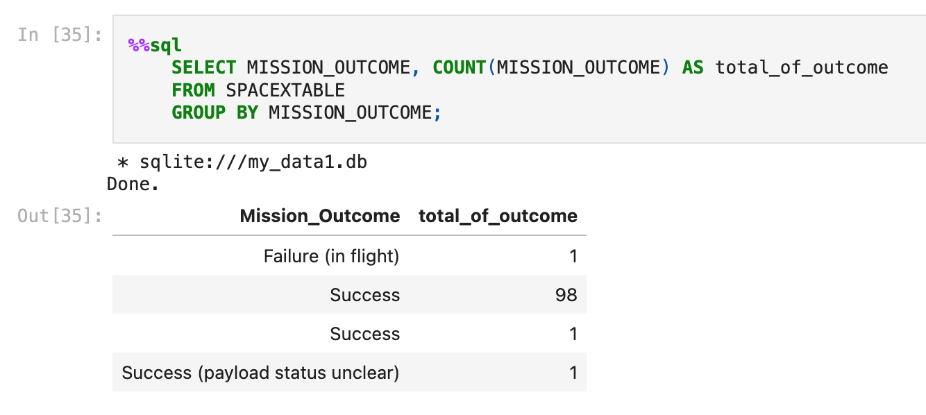
Total Number of Successful and Failed Mission Outcomes
The use of the COUNT() function and GROUP BY clause returns the total number of successful and failed mission outcomes.

Slide 31
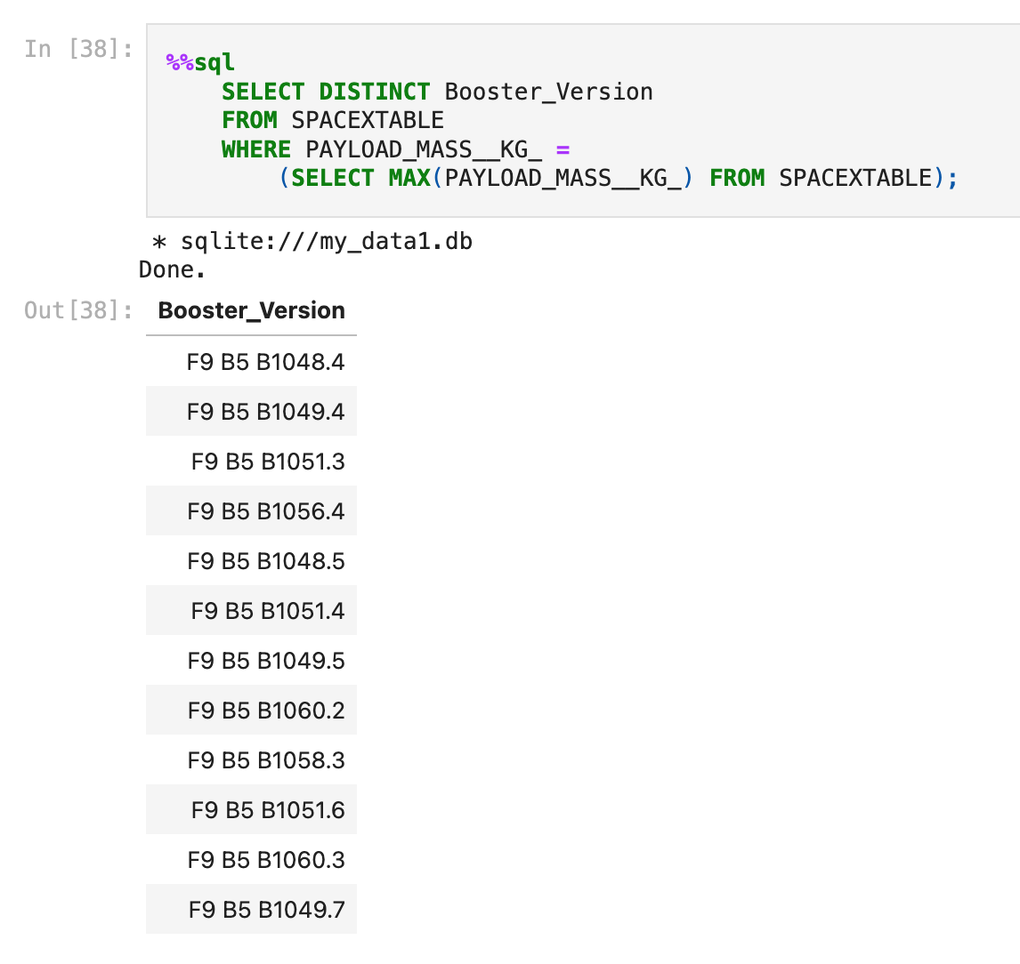
Boosters Carried Maximum Payload
The combination of the DISTINCT operator in the SELECT clause, and the use of a subquery in the WHERE clause returns the list of unique boosters with the maximum payload in the entire dataset.

Slide 32
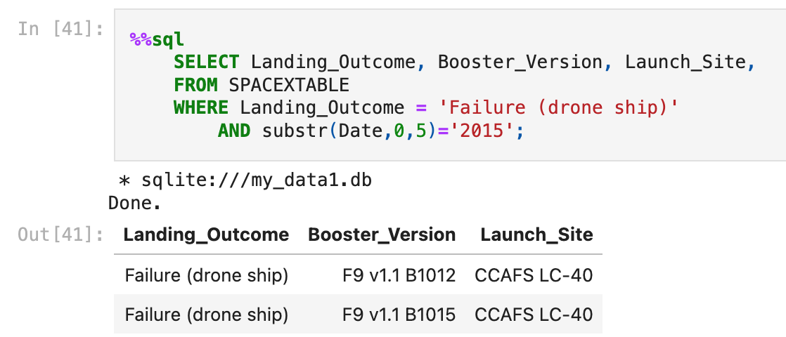
2015 Launch Records
The use of the substr() function allows for a result that includes important launch data in the year 2015.

Slide 33
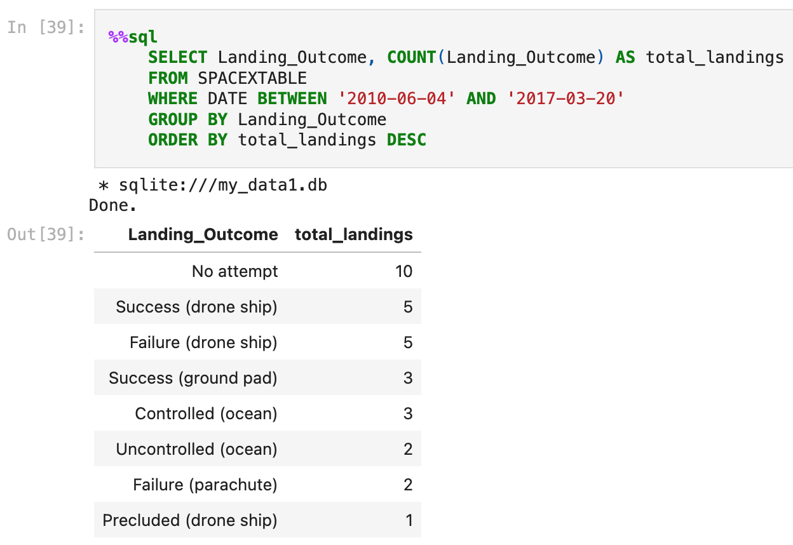
Rank Landing Outcomes Between 2010-06-04 and 2017-03-20
The combination of the aggregate COUNT() function, the WHERE, GROUP BY, and ORDER BY clauses returns a ranked lists of landing outcomes between June 4th 2010 and March 20th 2017.

Slide 34

Section 3

Slide 35
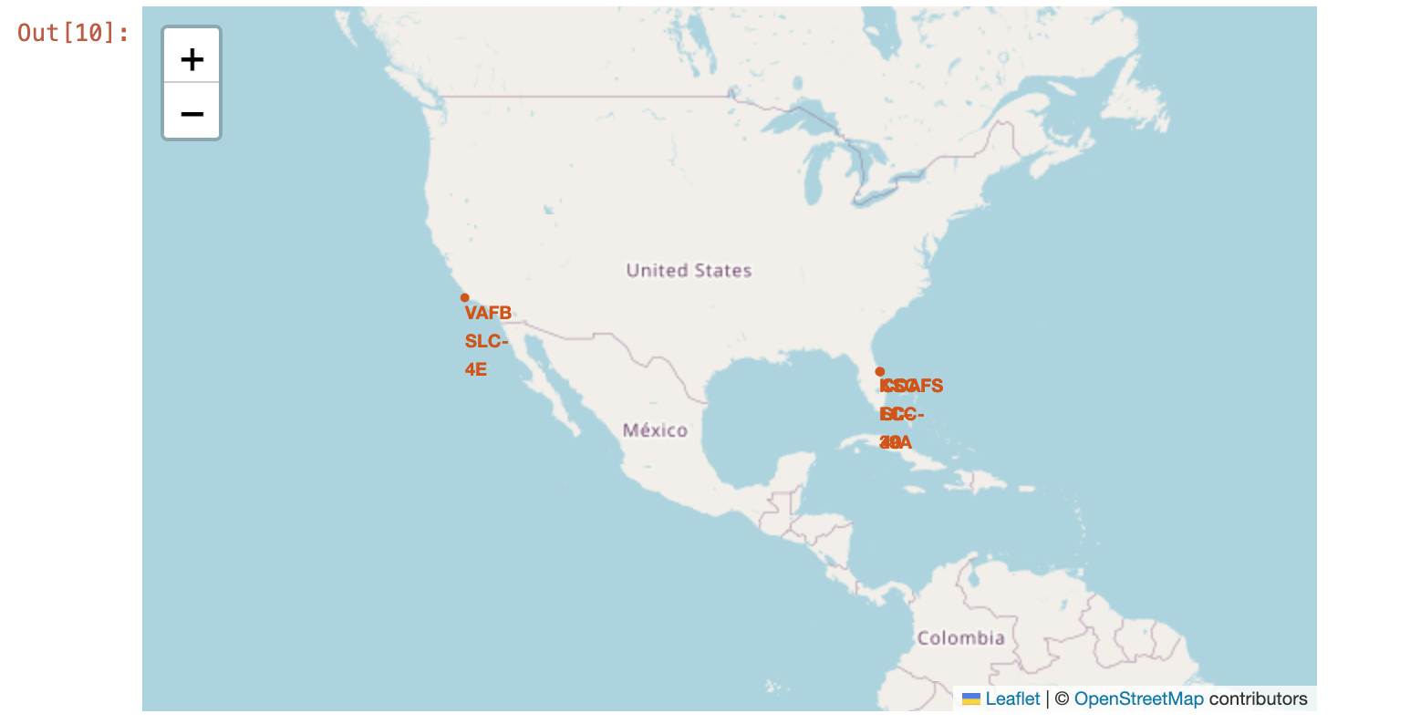
Global Map Markers for All Launch Sites
The two primary launch sites are on opposite coasts of the United States.

Slide 36
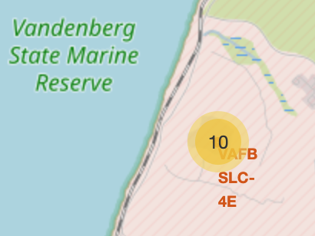
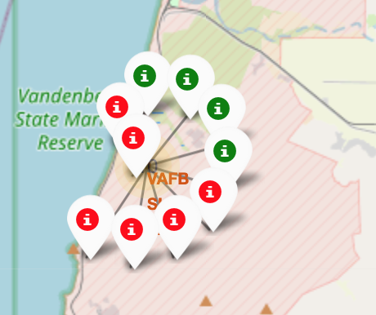
Color Coded Launch Outcomes
Using the interactivity provided by Folium maps, we can navigate to specific launch sites and view color coded outcomes. Successful landings are in green, unsuccessful landings are in red.

Slide 37
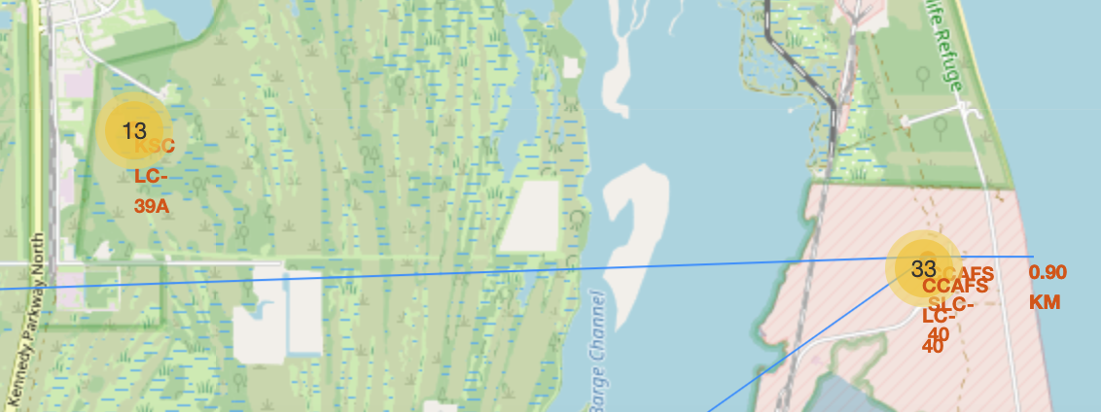
Launch Site Proximity to Notable Areas
This map utilizes distance lines, markers, and distance circles to display the relative proximity to the nearest highways, cities, railways, and coastlines to each respective launch site.

Slide 38

Section 4

Slide 39

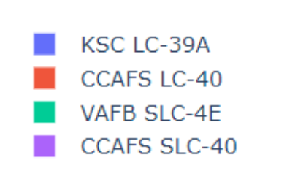
Success by Launch Sites
This pie chart details the percentage of successful launches by launch site
KSC LC-39A was the most successful launch site.

Slide 40
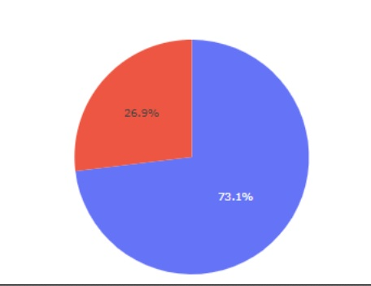
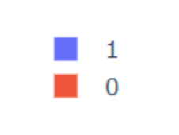
Launch Site KSC LC-39A Success Ratio
KSC LC-39A had the highest success ratio (1 = successful launch, 0 = unsuccessful launch) at 72.1%

Slide 41
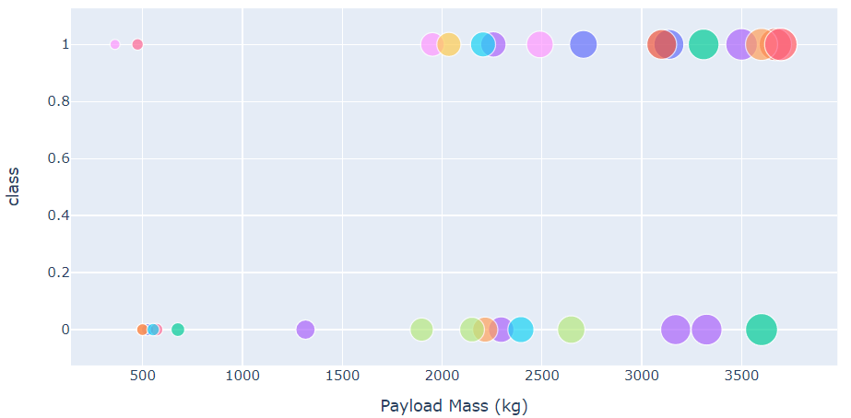
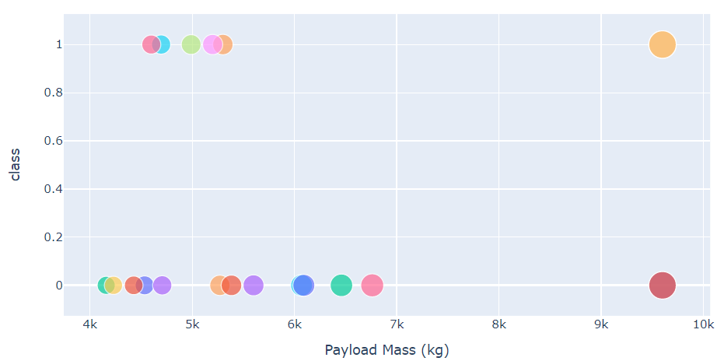
Payload vs. Launch Outcome
Using the slider function in the Plotly Dashboard, we can investigate the relationship on payload vs launch outcome.
As displayed below, the success rate is higher when a payload weight is lower; a negative relationship
Low Payload Weight High Payload Weight
(O-40kg) (4k-10k kg)

Slide 42

Section 5

Slide 43

Classification Accuracy
When comparing all models against each other, the DecisionTree model has the highest accuracy, with a score of 0.87.

Slide 44
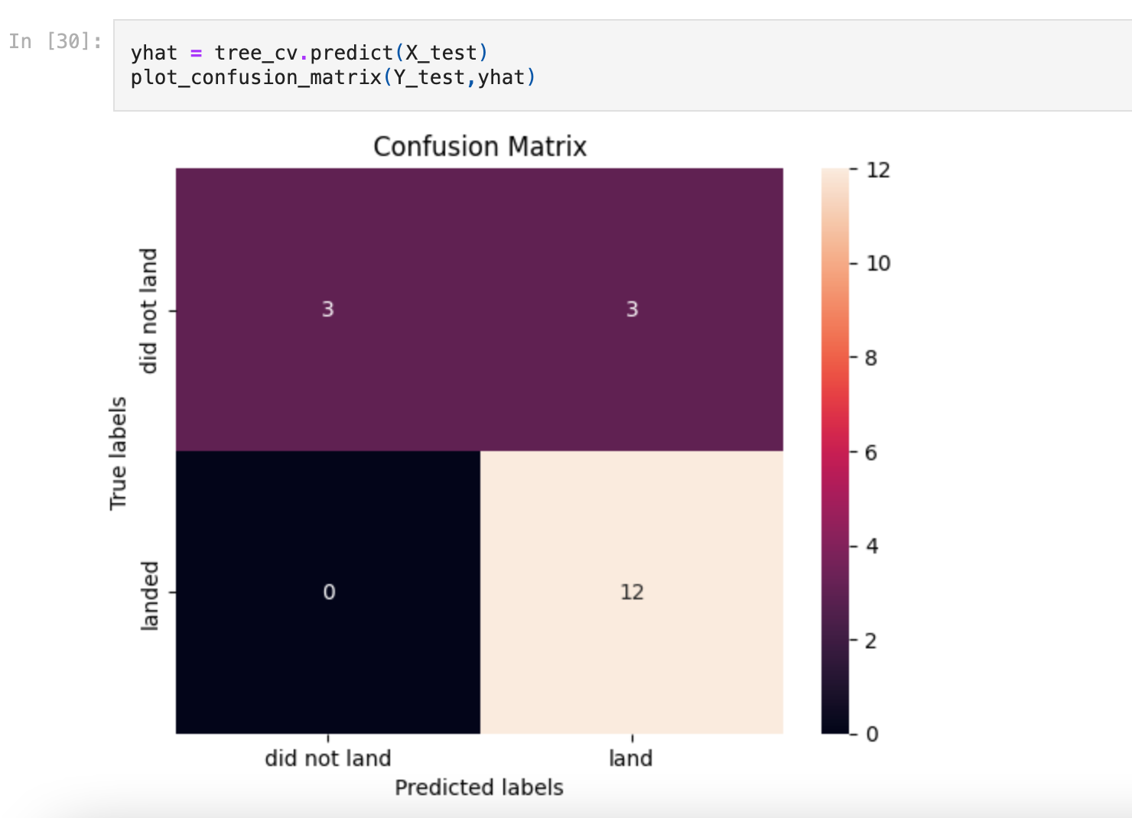
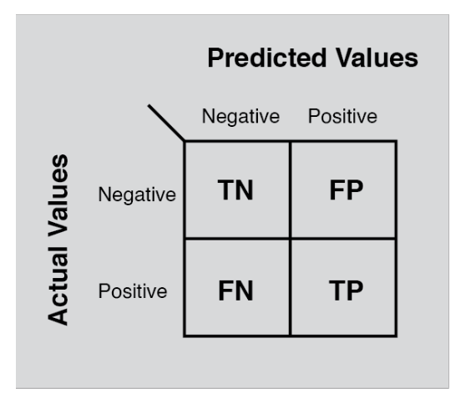
Decision Tree Confusion Matrix
In the case of the Decision Tree model, the biggest area of concern is Type I errors, also known as false positives. This is when a successful landing is predicted, but the actual landing is unsuccessful.

Slide 45
Conclusions
Given the analysis performed and the development of predictive machine learning models, we can conclude that:
Success rates have improved in the years 2013-2020
The most successful orbits are ES-L1, GEO, HEO, SSO, VLEO
Smaller payloads have more successful launches
Higher flight numbers have more successful launches
KSC LC-39A is the most successful launch site, with a success ratio of 72.1%
The Decision Tree model is the most effective to predict future launch success

Slide 46

Appendix
Here is the link to the GitHub repository with all completed notebooks, code files, and this presentation in pdf format: https://github.com/stephaniegoodman/spacex_flightanalysis

Slide 47


